Slide 1
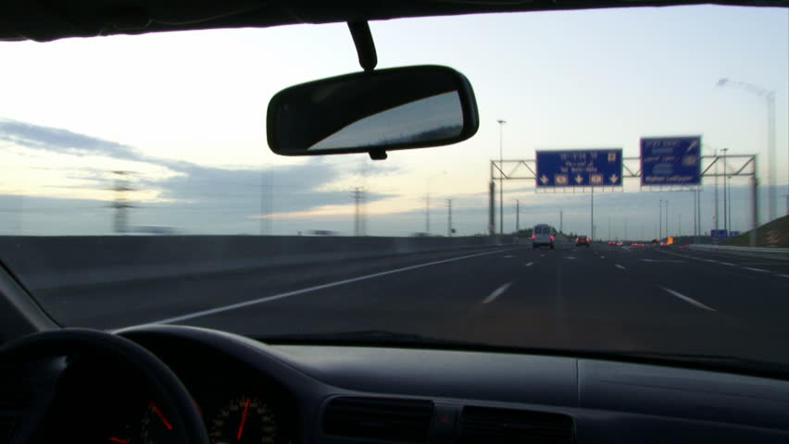
Seeing while moving
Björn Jörges & Laurence R. Harris
Notes:
Heya! Thank you so much for agreeing to participating in our experiment. The idea of this project is to have a look at what happens when we move while we try get an idea of how objects move through the environment.

Slide 2
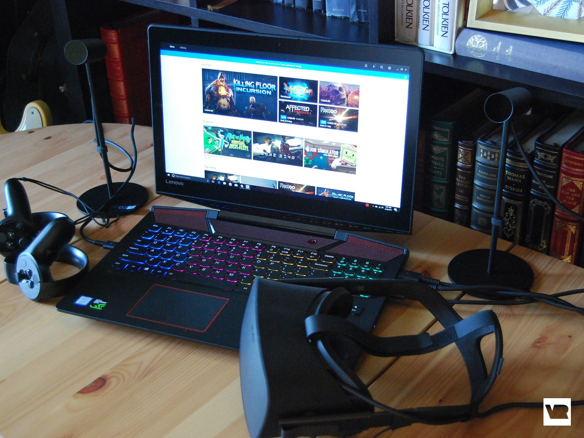

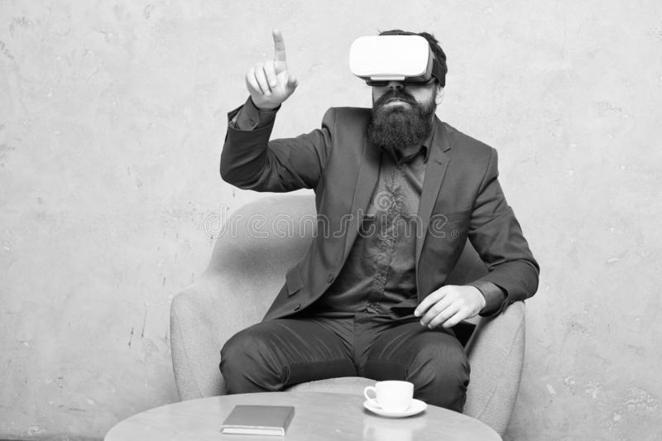
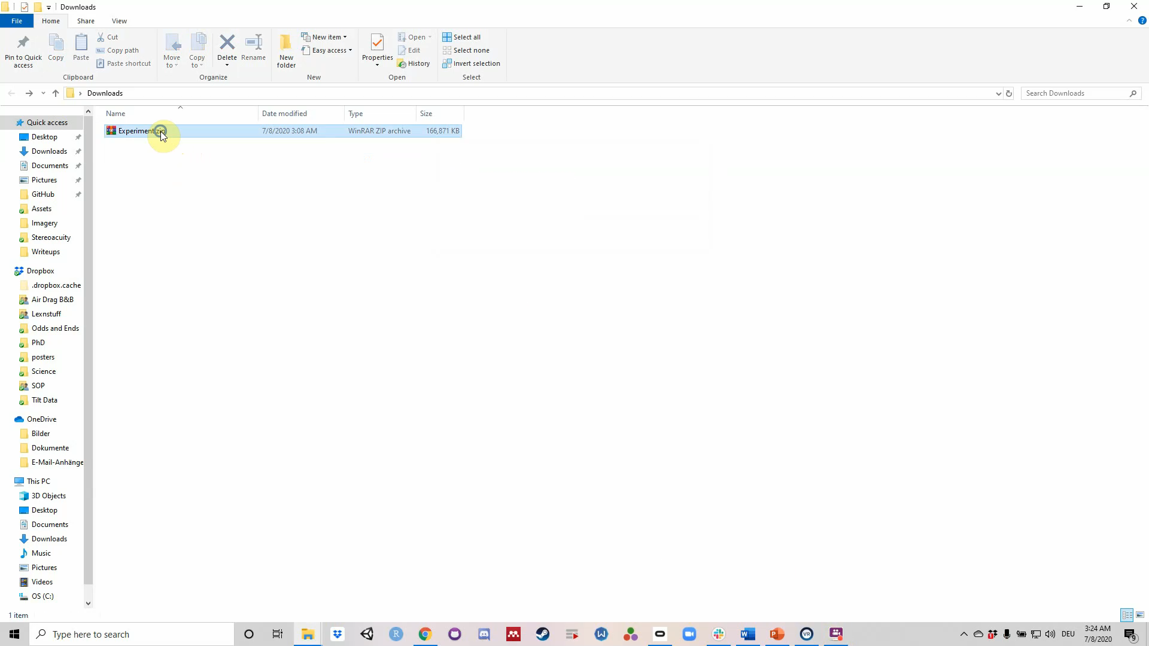
General information
Seat yourself with Oculus Rift and controllers
Four parts:
A Stereovision Test (2 minutes)
A Training Session (2-4 minutes)
The Main Experiment (50 minutes)
A Short Assessment of Self-Motion Perception (2 minutes)
Fill in and sign the informed consent form!
Notes:
- Presentation in VR
- Break/stop if motion sick
Use “X” or “A” to re-center the environment or turn towards the scene
ESC to exit, but data lost

Slide 3
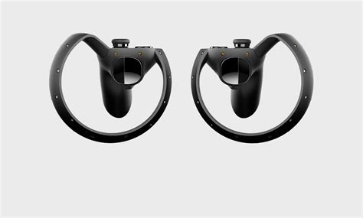
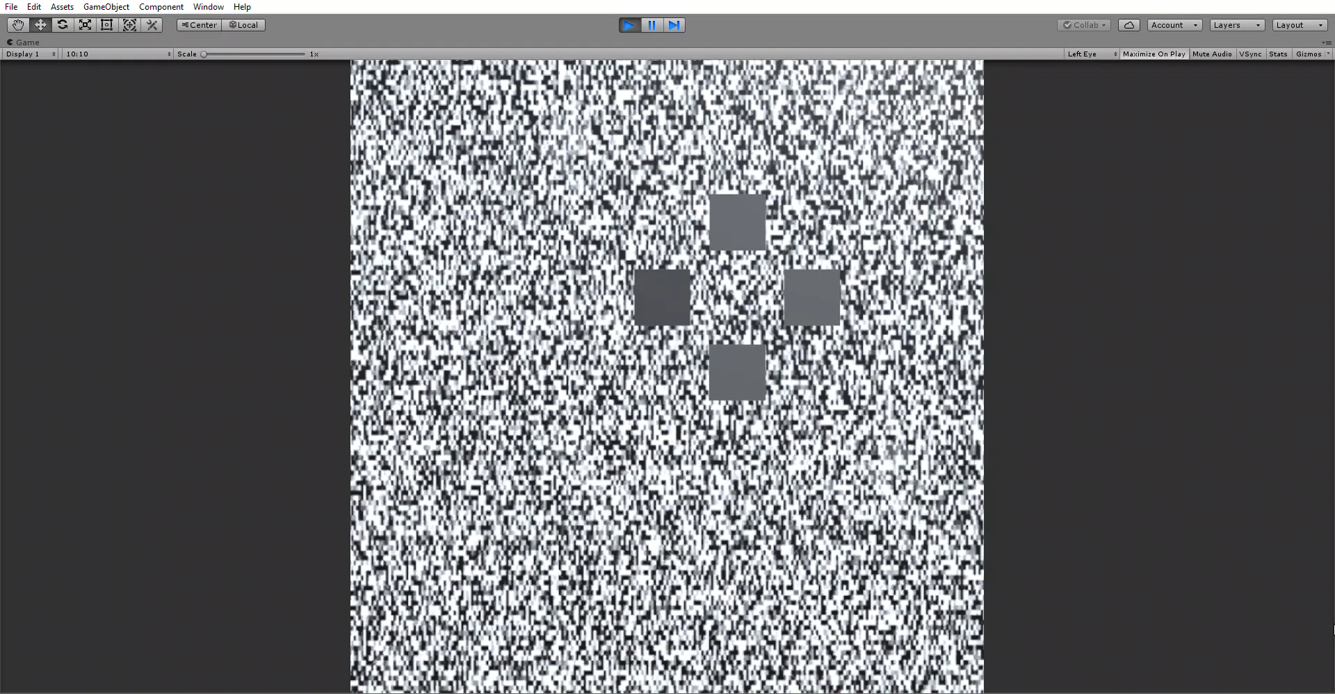
First task: Stereovision Test
How good is your stereoacuity?
Which one pops out?
Use Joystick to choose and Trigger to confirm and go to next trial
Notes:
20 trials, becomes harder over time
Takes about 2 minutes

Slide 4
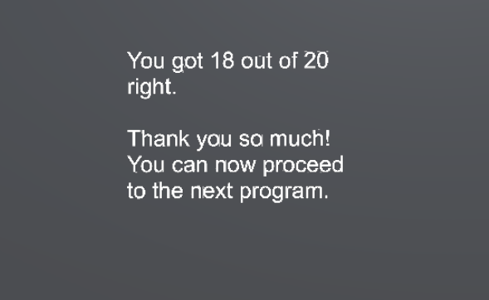
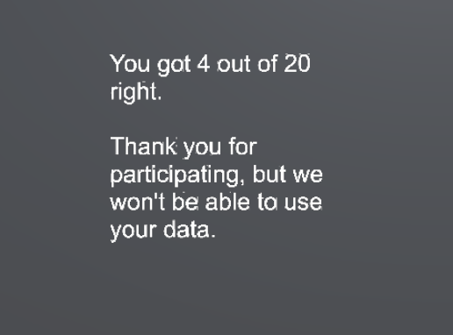
Can we use your data?
Yes! Onwards to Task 2
Unfortunately not – no need to continue
Notes:
Send us the data file and we can still give you a little compensation for the effort
This is NOT a medically diagnostic tool!

Slide 5
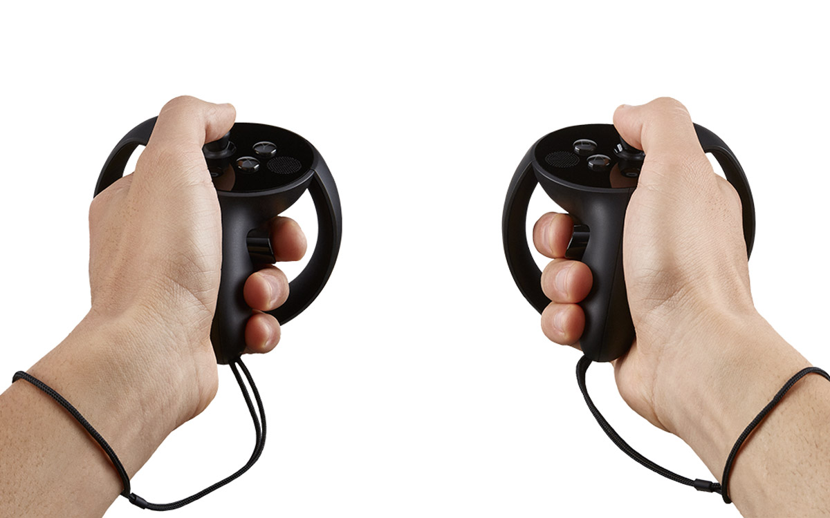
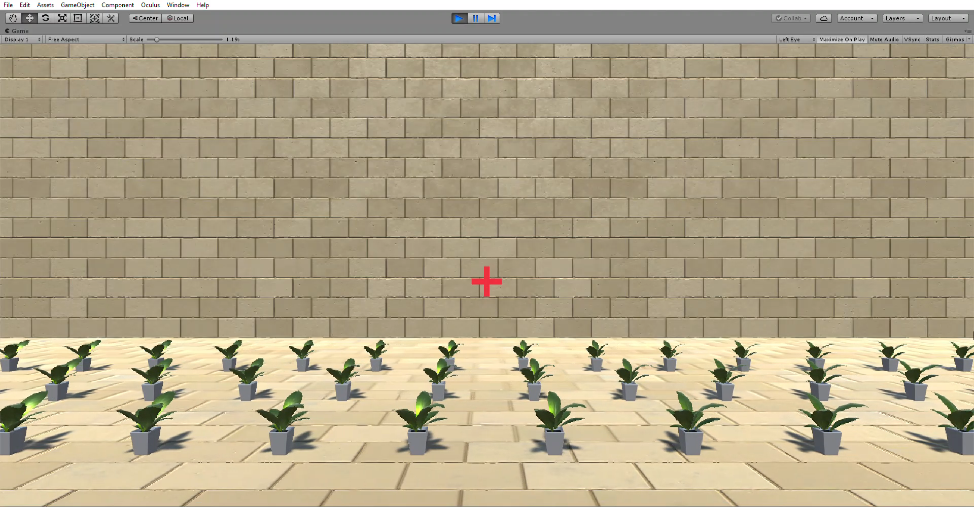
Task 2: Training Session
If the FIRST motion was faster, press the Trigger of the left controller
Which one is faster, the first motion or the second motion?
Press the Trigger of the right controller if the SECOND motion was faster
Notes:
Not sure = guess
Takes about 2 minutes (35 comparisons)

Slide 6
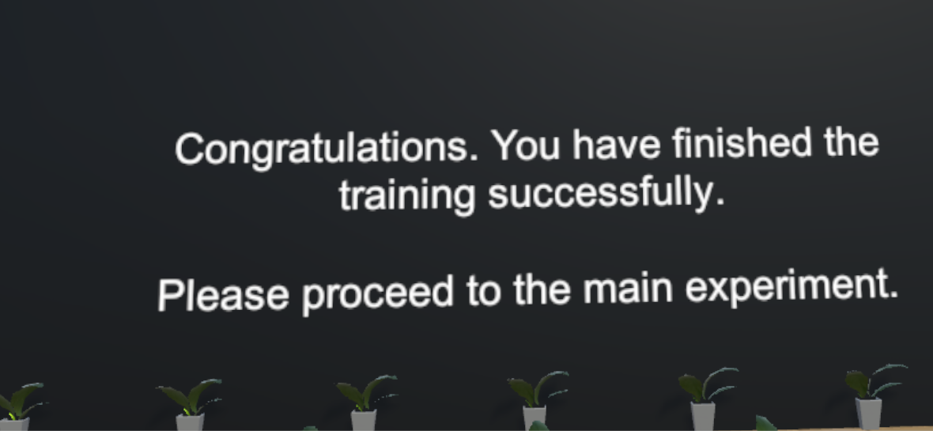
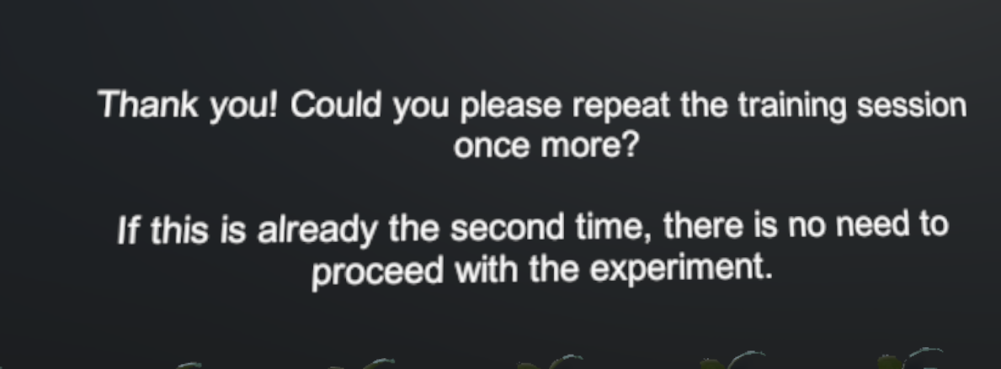
Can we use your data?
Please repeat the training. If you get the same screen the second time around, we won‘t be able to use your data – no need to continue
Yes! Onwards to Task 3

Slide 7
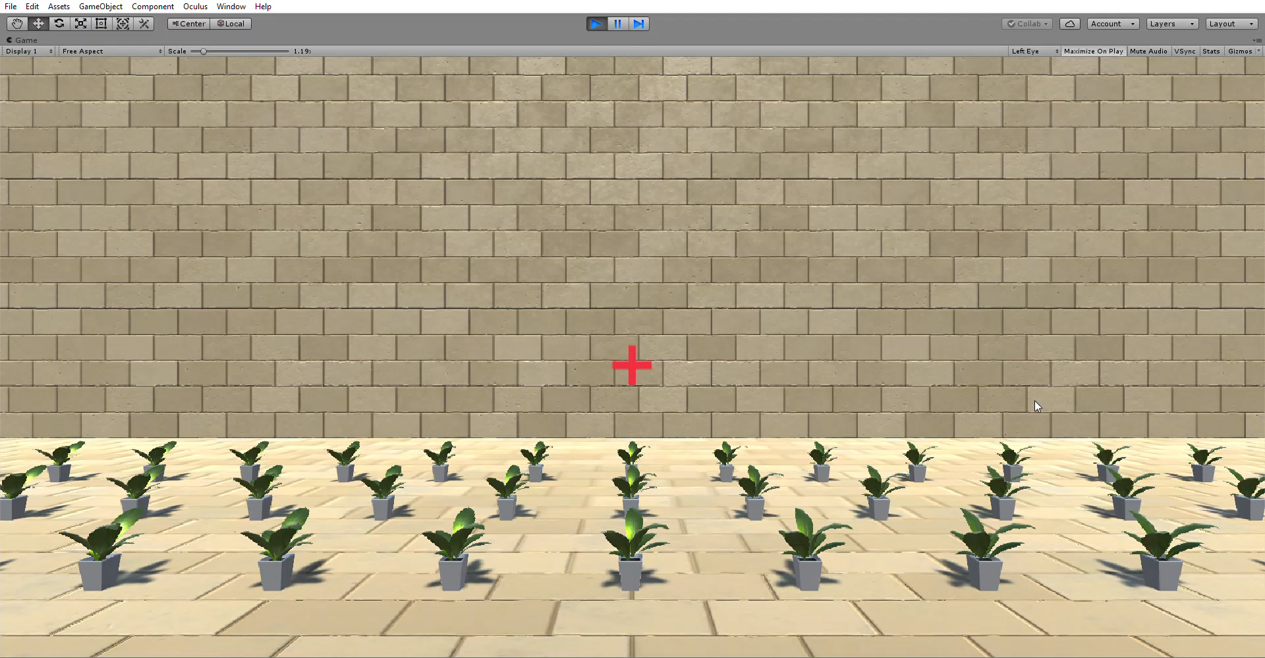
Task 3: Main Experiment
If the FIRST motion was faster, press the Trigger of the left controller
Which one is faster, the first motion or the second motion?
Press the Trigger of the right controller if the SECOND motion was faster
Same as before, but sometimes you move, sometimes the wall moves and sometimes the wall is blank
Notes:
- Takes 40-50 minutes overall, take breaks!

Slide 8
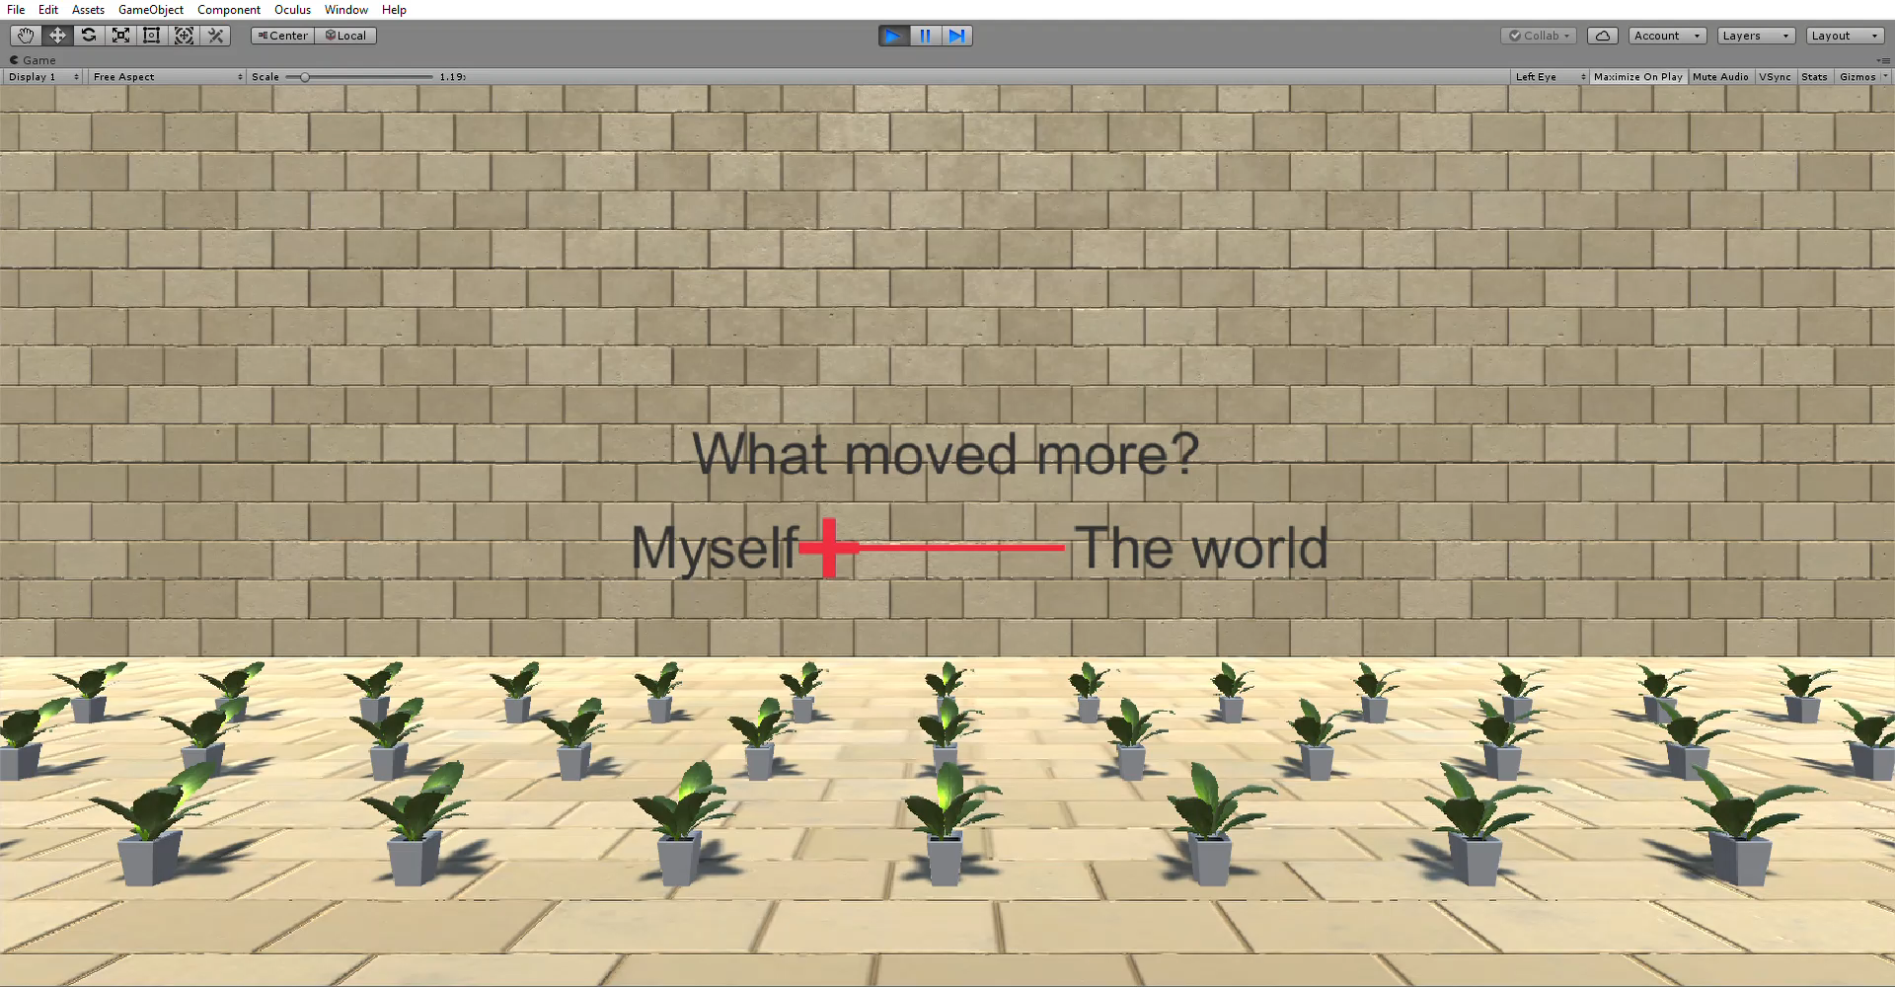
Task 4: Self-Motion Assessment
What moved more? You? The world? The wall?
Use Joystick to move the slider and Trigger to confirm and go to next trial

Slide 9
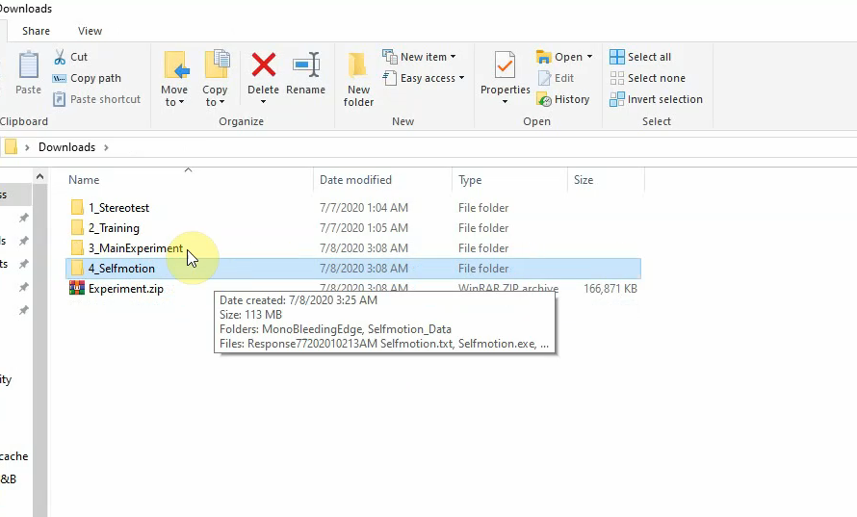
Wrap-up
Look for the data files for all four experiments: .txt files in the folders with the .exe files
„... Stereotest.txt“
„... Training.txt“
„... MainExperiment.txt“
„... Selfmotion.txt“
Send files to us, make sure you sent the informed consent form

